Slide 1
What is Auto-Sklearn?
auto-sklearn is an automated machine learning toolkit and a drop-in replacement for a scikit-learn estimator.
It represents a platform based on supervised machine learning that's ready for use. It automatically searches for the correct machine learning algorithm for a new dataset and optimizes its hyperparameters.
It leverages recent advantages in Bayesian optimization, meta-learning and ensemble construction.

Slide 2
Main Features
Automatic Algorithm Selection
Automatic Hyperparameter Tuning

Slide 3
Main Modules
Classification: autosklearn.classification
Regression: autosklearn.regression

Slide 4
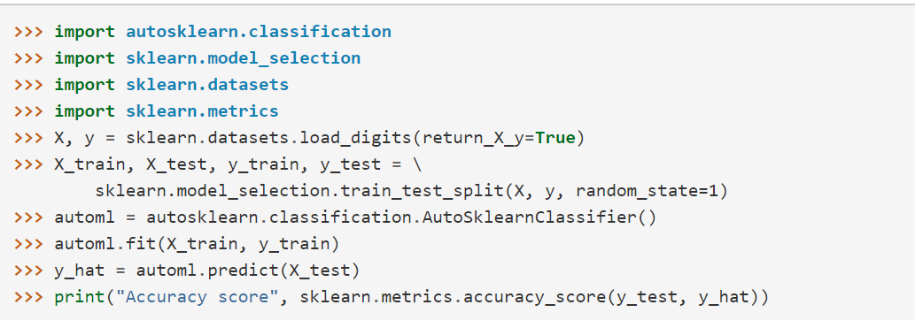
Example

